Slide 1

MindGuard: An Intelligent Assistant for Student Stress Management
Group Members:
Kashparov Georgii(1820259023), Semenov Artem(1820259035), Kuranov Grigorii(1820259061)
Course: Introduction to Big Data
Group: Snake 🐍
Date: 2025/11/02

Slide 2

Main Content of the Project
The Problem
Our Solution
Student mental health is a critical issue. High levels of stress and depression can negatively impact academic performance, social life, and long-term well-being. Existing solutions are often generic and not tailored to an individual's specific situation.
We propose the development of "MindGuard," a software prototype designed to act as a personal assistant for managing student stress. The system will provide a two-step approach:
Diagnosis: Using a predictive machine LM to accurately assess a student's current stress level based on their answers to a short survey.
Support: Employing a powerful generative model to provide personalized recommendations based on the diagnosed stress level and its key contributing factors.

Slide 3

Core Functionality
The user interacts with a simple interface, answers questions about their psychological, academic, and social state. The system then analyzes these inputs, predicts their stress level (Low, Medium, High), and generates unique, relevant advice to help them cope and improve their situation.

Slide 4
Project Tasks
Our project is divided into six key phases:
01
02
Phase 1: Data Analysis and Preprocessing
Phase 2: Predictive Model Development
Perform Exploratory Data Analysis (EDA) to understand the relationships between different factors and stress levels. Visualize key features. Prepare the data for model training (scaling, encoding).
Train several machine learning classification models (e.g., Logistic Regression, Random Forest, Gradient Boosting) to predict stress_level. Evaluate models using metrics like Accuracy, Precision, Recall, and F1-score. Select the best-performing model for our prototype.

Slide 5
Project Tasks
Our project is divided into six key phases:
03
04
Phase 3: Generative AI Integration
Phase 4: Software Prototype Development
Set up access to a generative model API. Develop and test effective prompts ("Prompt Engineering") that instruct the AI to generate safe, empathetic, and useful advice based on the model's output.
Design a simple user interface (UI) for the application. Develop the front-end (where the user answers questions) and back-end logic.

Slide 6
Project Tasks
Our project is divided into six key phases:
05
06
Phase 5: System Integration and Testing
Phase 6: Final Documentation and Presentation
Combine the predictive model, generative AI API, and user interface into a single working application. Conduct end-to-end testing to ensure the system works as expected.
Write the final project design report. Prepare the final PowerPoint presentation and rehearse the demonstration.

Slide 7
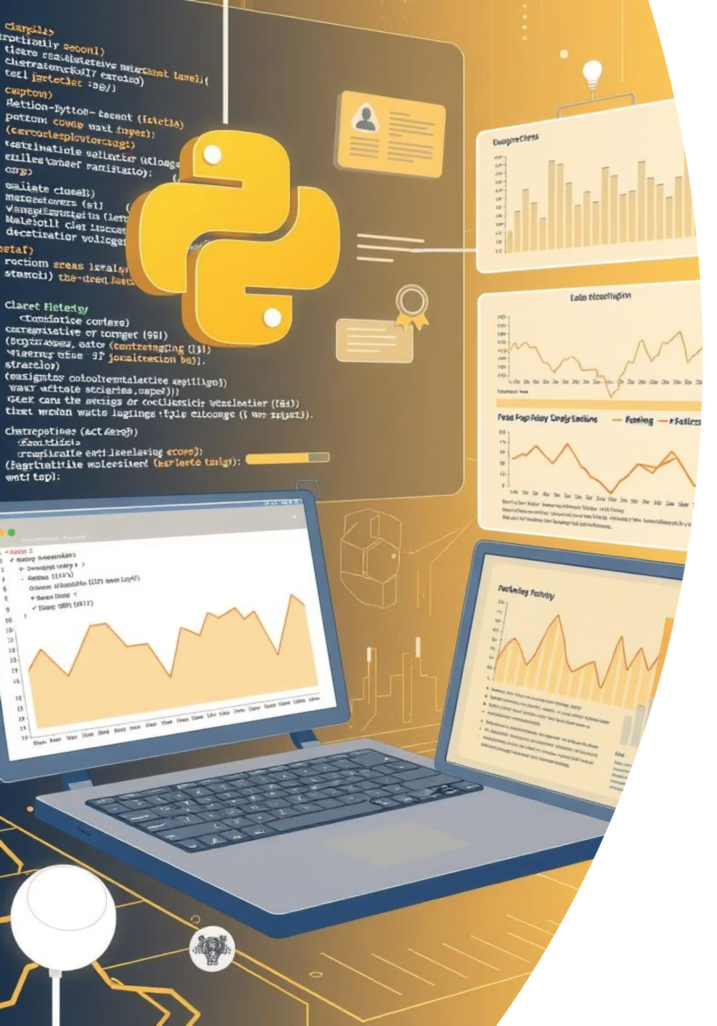
Technical Solutions: Programming & Data Science Stack
Programming Language & Environment
Data Science & Machine Learning Stack
Language: Python 3.9+
Data Manipulation: Pandas, NumPy.
Development Environment: Jupyter Notebooks (for research and analysis), Visual Studio Code (for application development).
Data Visualization: Matplotlib, Seaborn.
ML Framework: Scikit-learn.
Model: XGBoost_1_AutoML
Version Control: Git & GitHub.

Slide 8

Application Files Overview
File | Description
model.py | Performs data analysis (EDA, visualizations, correlations).
app.py | Streamlit app (user interface + backend logic).
StressLevelDataset.csv | Dataset with student responses.
.env | Stores API key securely (GEMINI_API_KEY=your_key)
requirements.txt | List of required dependencies.

Slide 9
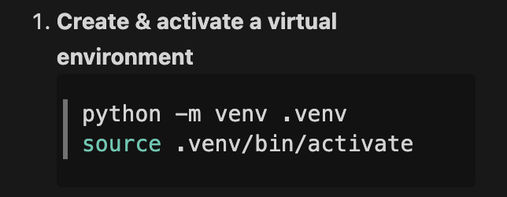
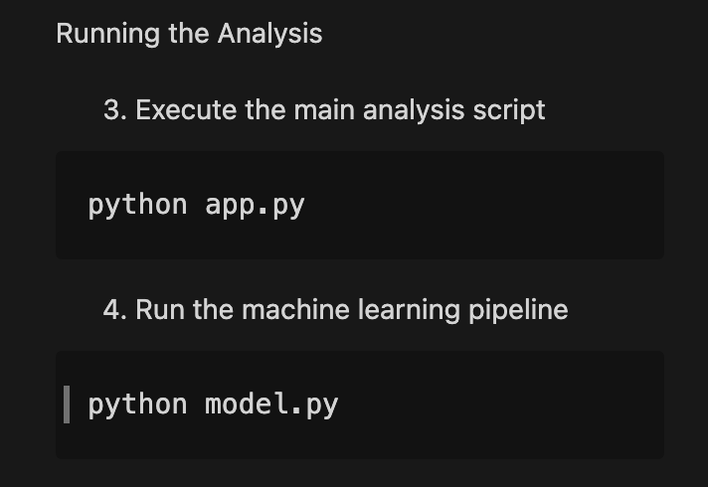
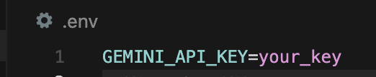
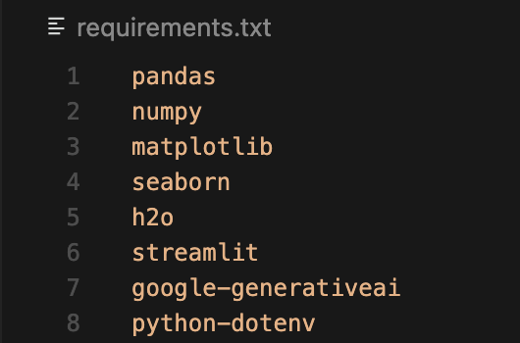
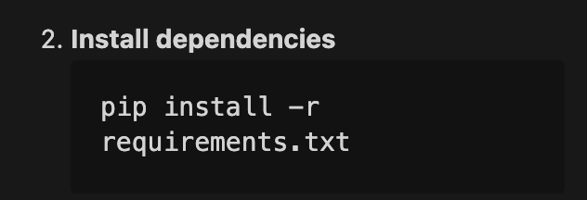

Quick Start

Slide 10
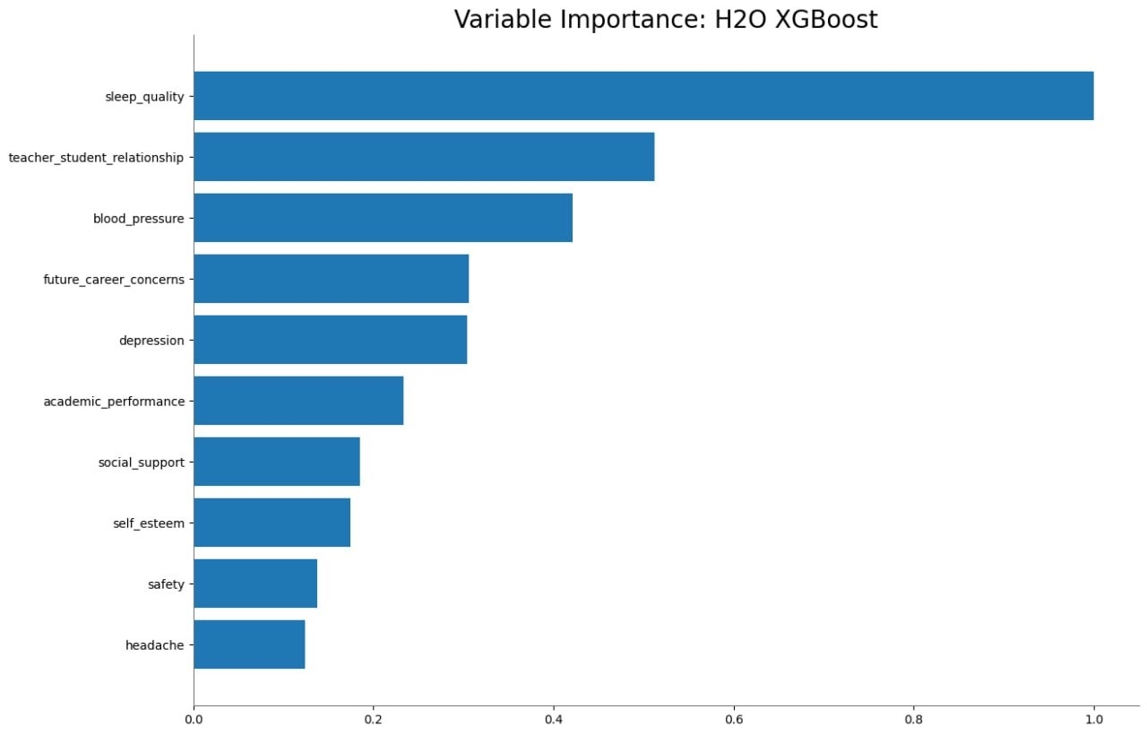
Data Science Methodology & Dataset
Generative AI Uses the top 5 most important factors from the prediction: Sleep Quality, Teacher-Student Relationship, Future Career Concerns, Depression Level, Academic Performance, and generates personalized recommendations based on them
Data Source & Preprocessing
Dataset: Student Stress Monitoring Datasets
Records: 1,100 student entries
Features: 21 unique psychological, social, and physiological factors
Data Quality: High integrity, no missing values
Preprocessing: Standard Scaling applied to normalize feature scales for optimal model performance

Slide 11
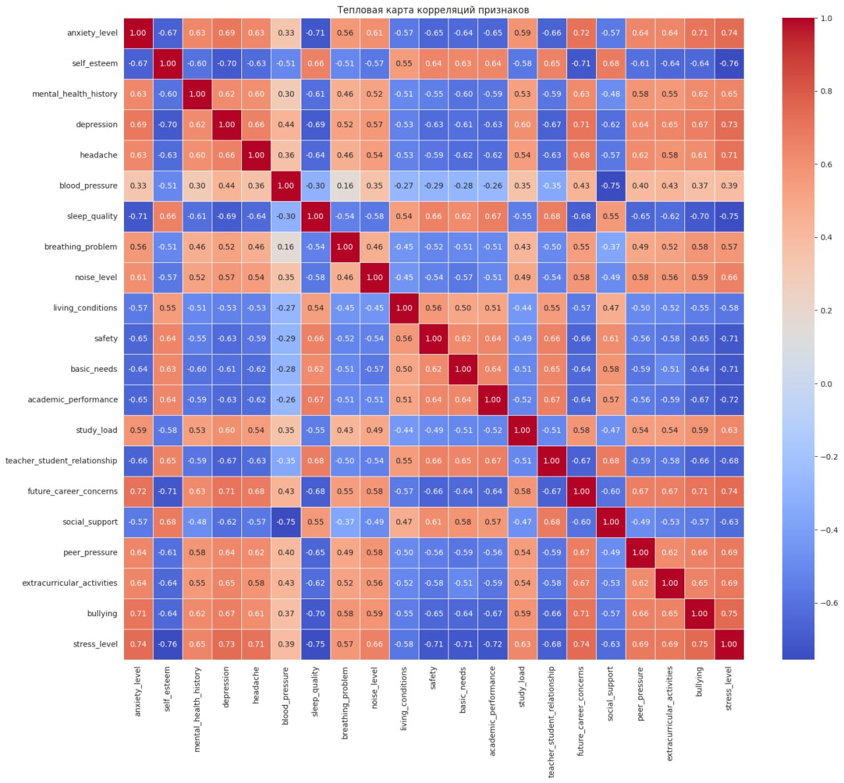


Data Analysis & Model Building
EDA performed in model.py
Frameworks: pandas, numpy, matplotlib,seaborn
Correlation analysis found strong links between:
anxiety_level ↗ stress_level
self_esteem ↘ stress_level
Best model (via H2O AutoML): XGBoost Classifier, Accuracy = 87.88%

Slide 12
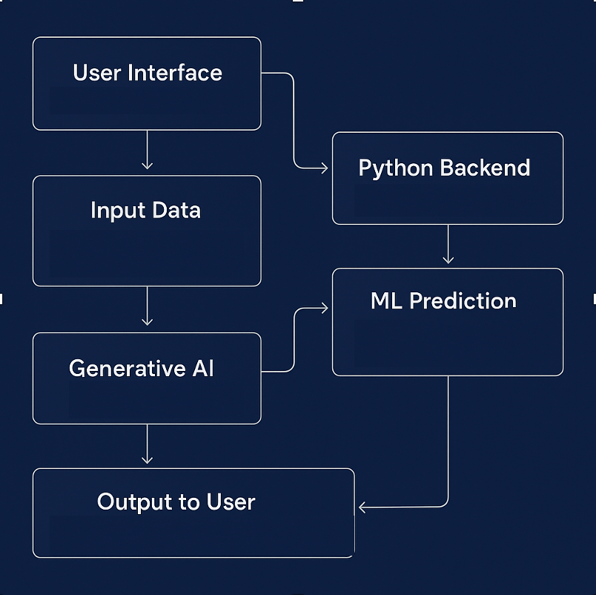

WorkFlow
Our ML workflow delivers stress assessment and AI-powered advice in 3 seamless steps: User inputs 8 key parameters via sliders → XGBoost model analyzes 21 features to predict stress level (87.88% accuracy) and identifies top contributing factors → Gemini AI generates personalized recommendations based on specific stress profile. Complete automated pipeline from data to actionable advice in under 5 seconds.

Slide 13
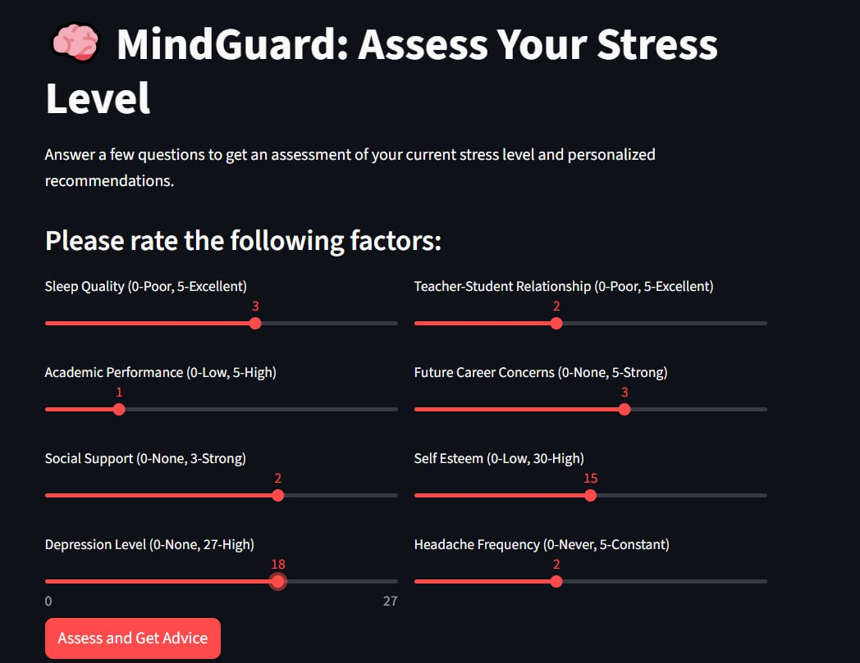
Client Path. User Interface
Step 1: User opens the MindGuard web page
Step 2: Adjusts sliders (sleep, anxiety, etc.)
Step 3: Clicks “Analyze My Stress”
Step 4: Backend predicts stress level via ML model

Slide 14

Step 5: Gemini AI provides advice
Step 6: Results shown instantly (diagnosis + recommendations)

Slide 15
Python backend
Component | Description
Data Processing | Receives input data from Streamlit (all slider values), checks for validity, and normalizes them on a 0–10 scale.
ML Model Integration | Sends processed data to the trained XGBoost model (via H2O AutoML) and retrieves the predicted stress level (0 – Low, 1 – Medium, 2 – High).
Interpretability Layer | Identifies the top 3–5 most influential features (from feature importance) that contributed to the prediction.
Generative AI Connector | Builds a structured prompt using the ML results and key factors → sends it to Gemini 2.5 Pro API → receives personalized, empathetic advice
Security Layer | Uses a .env file and the python-dotenv library to securely manage and protect API keys.
Response Builder | Combines the ML prediction and AI-generated advice, and returns the final output to the Streamlit interface for display.

Slide 16
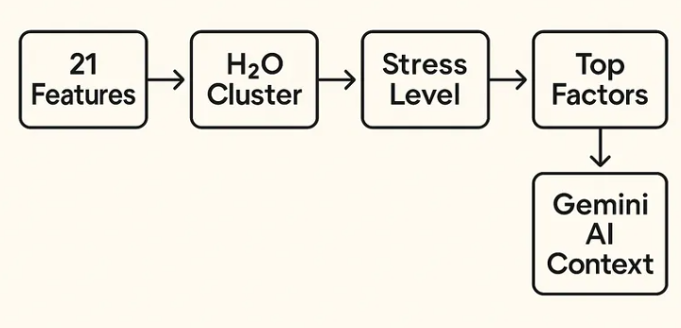

ML Prediction
Our ML system predicts stress with 87.88% accuracy and provides explainable results. The top 5 factors serve as context for generative AI, creating a pipeline from data to diagnosis to personalized recommendations. This represents a fundamentally new level of ML and AI integration: instead of a "black box" - a transparent system; instead of generic advice - targeted recommendations; instead of separate tools - a unified workflow. Practical value: when sleep quality is poor and career anxiety is high, AI suggests sleep techniques; when facing issues with teachers and self-esteem - communication exercises; under high workload and isolation - time management strategies. We've created a closed-loop data-driven support system: Data → Diagnosis → Causes → Action.
All in all, we transform raw data into actionable support, providing not just state assessment but a clear improvement path through the combination of ML precision and AI flexibility. The result: a system that not only diagnoses problems but also helps solve them.
Performance Metrics
Accuracy: 87.88% (exceeds 80% target)
Prediction Classes: 0 (Low), 1 (Medium), 2 (High) stress levels
Inference Time: < 1 second for real-time assessment

Slide 17
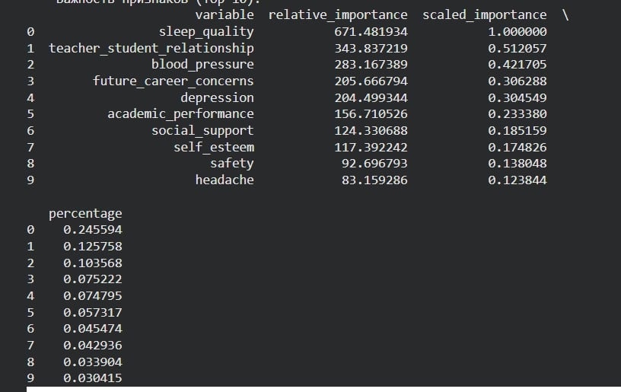
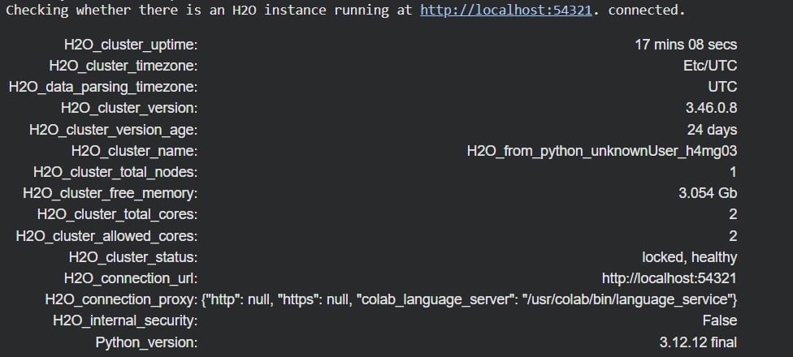
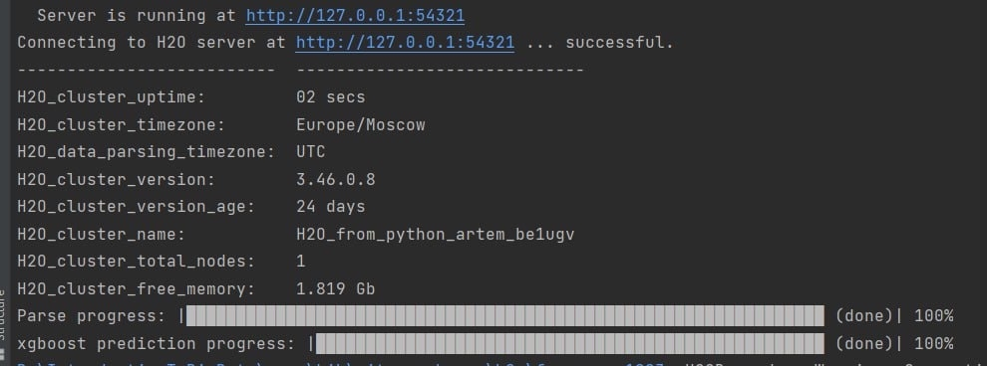

Our ML engine runs on a stable H2O cluster, version 3.46. The cluster has been running flawlessly for over 17 minutes, utilizing 2 CPU cores and 3GB of memory. This demonstrates the reliability and efficiency of our infrastructure for production deployment.
This is the feature importance analysis from our XGBoost model. We can see that sleep quality is the absolute leader with 24.6% importance, confirming our initial hypotheses. Interestingly, academic performance ranks only 6th – a crucial insight showing that psychosocial factors often outweigh purely academic ones in predicting student stress
The connection process to the H2O server takes less than 2 seconds. The cluster operates in the Moscow timezone and is ready to handle requests. This confirms that our system provides fast response times for end-users

Slide 18




Major Issues and Technical Challenges
Prompt Engineering
API Management
Creating prompts that generate consistently high-quality, safe, and relevant advice is a major challenge. The AI must be carefully instructed to avoid giving medical diagnoses or harmful suggestions.
Managing API keys securely and handling potential API latency or rate limits. We need to ensure our application is responsive.
Model Interpretability
Ethical Considerations
Understanding why the model predicts a certain stress level. This can be important for generating more relevant prompts for the generative AI.
Ensuring user data privacy and the responsible use of AI for mental well-being support. The application must clearly state it is not a replacement for professional medical help.

Slide 19




Final Outcomes
By the end of this project, we deliver:
A high-performance classification model
A machine learning model trained on the Student Stress Dataset, achieving 87.88% accuracy, exceeding the initial goal
of 80%. The best model was XGBoost (via H2O AutoML). student stress levels with an accuracy of over 80%.
A fully functional software prototype
A working Streamlit web application that allows users to input their psychological, social, and academic data,
instantly predicts their stress level, and provides personalized AI-generated advice.
An effective AI integration
Seamless connection with Google Gemini 2.5 Pro API, which generates context-aware, empathetic
recommendations based on the top predictive factors identified by the model..
Comprehensive documentation
A complete design report and this presentation describing the project workflow, data processing, model
training, and system architecture.
A live demonstration
An end-to-end showcase of the MindGuard prototype — from data input to stress diagnosis and
AI-based personalized feedback

Slide 20

Research Summary
Tasks Completed
Next Steps
Defined the project concept “MindGuard” and developed the complete system architecture.
Deployment PostgreSQL throught some server
Sentiment
Conducted Exploratory Data Analysis (EDA) and identified key predictors of stress such as sleep quality, depression level, and teacher–student relationship.
Trained and evaluated multiple ML models; selected XGBoost (H2O AutoML) as the best performer.
Integrated Generative AI (Gemini 2.5 Pro) for personalized recommendation generation.

